Slide 1

Data as a Service
David Sietz
Software Developer / Technologist
Reference Material
https://github.com/dsietz/daas

Slide 2
1
setting expectations
2
anti-patterns
3
DaaS pattern
4
building DaaS with Talend Open Studio

Slide 3
1
setting expectations
2
anti-patterns
3
DaaS pattern
4
building DaaS with Talend Open Studio

Slide 4
what we want

Slide 5
available
self service
continuous integration
low maintenance
fast to market
current skillsets
scalable
no dark magic
continuous delivery
non-functional requirements
real-time
multi-sources
unstructured
formats
relational databases
various consumption
api
flat files
transform
aggregate & calculate
functional requirements

Slide 6
what we get

Slide 7
available
self service
continuous integration
low maintenance
fast to market
current skillsets
scalable
no dark magic
continuous delivery
non-functional requirements
real-time
multi-sources
unstructured
formats
relational databases
various consumption
api
flat files
transform
aggregate & calculate
functional requirements

Slide 8







BI Software
Can we get this in our website?
#!..*$#
olap layer
report layer
analysis
engine
portal
scheduler layer
data set layer
dashboard
engine
semantic layer
data access layer
structured
data warehouse
flat files
ecosystem / structured
unstructured
data provisioning
Notes:
A customer knocks on our door asking for a report based on his relational database
We stand up the latest vendor BI solution with a built in web portal for self-service
3. But the portal requires the dashboard engine > report layer > data set layer > semantic layer > data access layer > relational database
4. Customer asks for “data mining“ of his new unstructured data
5. So we purchase the analysis engine > olap layer > scheduler layer > ecosystem (make is structured)
6. The schedule layer stops which impacts the olap and the customer’s dashboard
7. Customer asks for integration with his application (which can only be done with too Much Effort)
8. Customer leaves

Slide 9
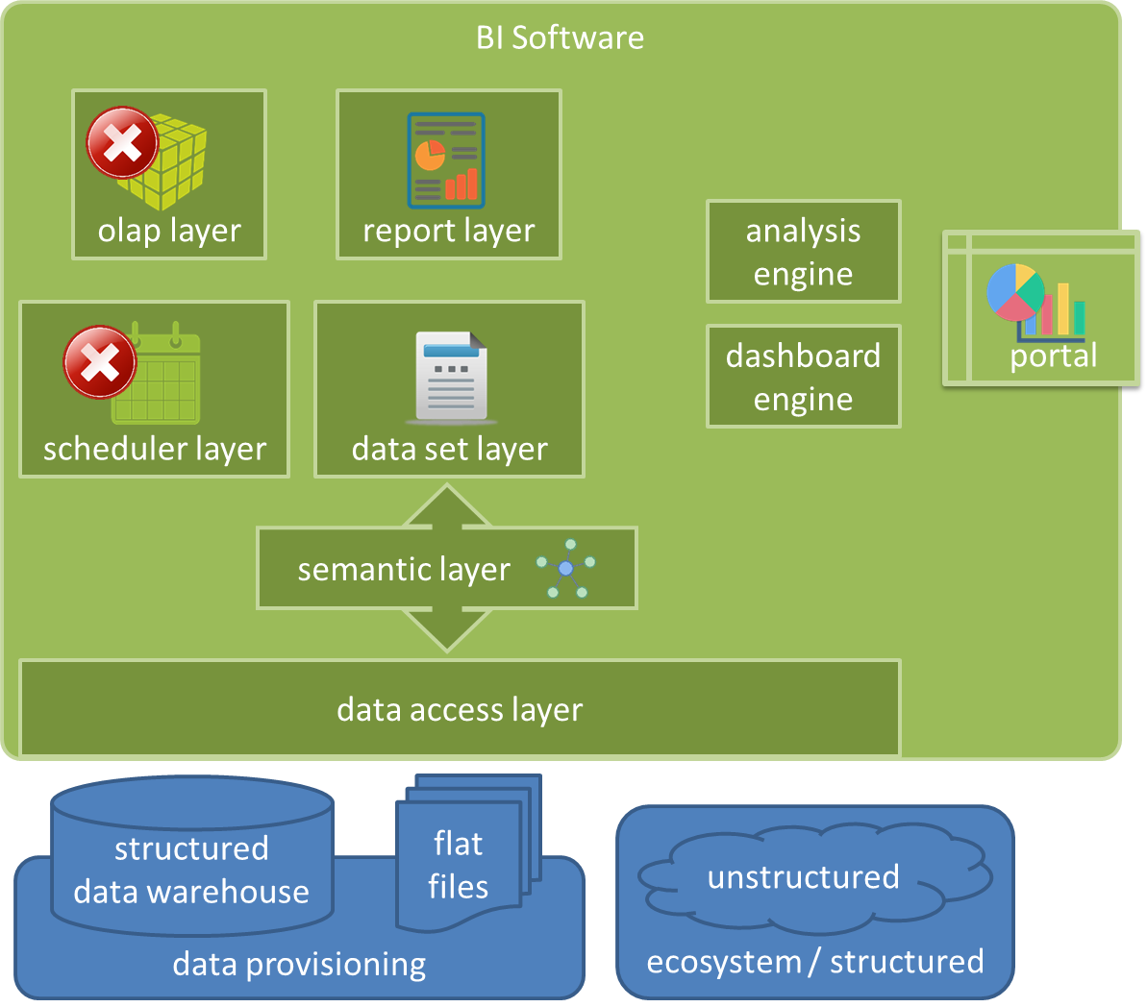

User interface layer
business layer
module
module
module
application layer
module
module
module
data layer
module
module
module
Notes:
Why couldn’t we meet our customer’s expectations?
Our IM system reflects the SOA architecture

Slide 10
1
setting expectations
2
anti-patterns
3
DaaS pattern
4
building DaaS with Talend Open Studio

Slide 11
BI Software
olap layer
report layer
analysis
engine
portal
scheduler layer
data set layer
dashboard
engine
semantic layer
data access layer
structured
data warehouse
flat files
ecosystem / structured
unstructured
data provisioning
Notes:
Sourcing of data through web service and ODS deltas from beginning

Slide 12


data staging anti-pattern
data provisioning steps are designed for bulk processing
real-time
or
scheduled
staging
scheduler
etl
target location
Notes:
Assumption that bulk processing is faster, but requires a timer which causes data latency

Slide 13


prepared menu anti-pattern
pre-process all combinations within a hierarchy
prepared
used
Notes:
Don’t know which combination will be asked for, so cache all possibilities

Slide 14
restricted endpoints
anti-pattern
sourcing | consumption
api layer
message broker
api layer
message broker
BI Software
staging
warehouse

Slide 15
1
setting expectations
2
anti-patterns
3
DaaS pattern
4
building DaaS with Talend Open Studio

Slide 16

Data as a Service pattern
IM system is a collection of services
client request
client request
client request
api layer
service
component
service
component
service
component
service
component
module
module
module
module

Slide 17
client request
client request
client request
api layer
service
component
service
component
service
component
service
component
module
module
module
module
message broker

Slide 18
Sourcing of Data
magic quadrants
real-time
unstructured
confirmation
retrievable

Slide 19
client request
client request
client request
api layer
service
component
service
component
service
component
service
component
service
component
module
module
module
module
module

Slide 20
service
component
service
component
interface
module
translator
meta
data persistence
Document Storage

Slide 21
service
component
switch(content-type){
case xml:
case csv:
case object:
default json:
}
{
_id : surrogate key,
author : “john smith”,
source_name : “app_01”,
source_uid : “5002634”
category : “monitoring”,
subcategory: “hardware”,
last_modified : 1490811072,
data_object : {
….
}
}
interface
interface
translator
translator
meta
meta
convert
xml to json
csv to json
object to json
data access
data persistence
save
Document Storage

Slide 22
service
component
interface
translator
meta
data persistence
Document Storage

Slide 23

Sourcing of Data
document storage - relational
event timestamp | _id | document
1490811072 | surrogate key | { _id: surrogate key, author : “john smith”, … }
message broker
service
component
module
versioning is performed and stored in the ODS

Slide 24
Sourcing of Data
document storage – NoSQL
{
_id : surrogate key,
_rev : 1,
author : “john smith”,
source_name : “app_01”,
source_uid : “5002634”
category : “monitoring”,
subcategory: “hardware”,
last_modified : 1490811072,
data_object : {
….
}
}
{
_id : surrogate key,
_rev : 2,
author : “john smith”,
source_name : “app_01”,
source_uid : “5002634”
category : “monitoring”,
subcategory: “hardware”,
last_modified : 1490811072,
data_object : {
….
}
}
versioning is performed automatically in same storage

Slide 25
Provisioning of Data
magic quadrants
real-time
self guided flow
variable load
parallel

Slide 26
Provisioning of Data
magic quadrants
real-time
self guided flow
variable load
parallel

Slide 27
Event Streaming Pattern
upstream
event mediator
downstream

Slide 28
Provisioning of Data
magic quadrants
real-time
self guided flow
variable load
parallel

Slide 29
Plugin Pattern
system flow
hook
hook
hook
plugin
plugin
plugin

Slide 30
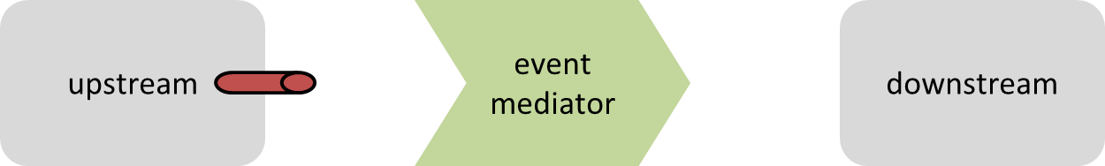
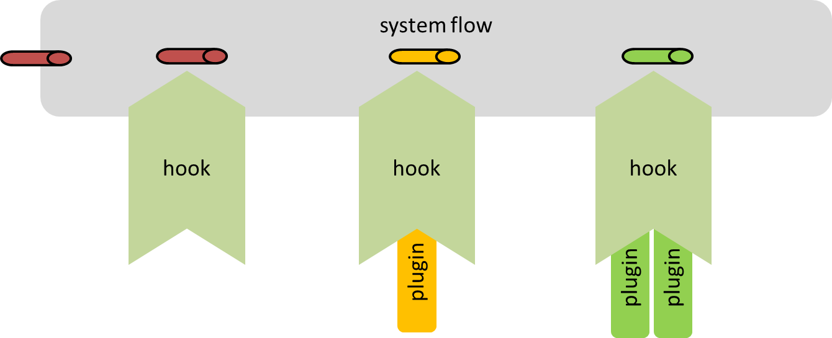
Provisioning of Data
real-time
self guided flow
parallel

Slide 31
Provisioning of Data
service model
service
component
module

Slide 32
service
component
interface
transformation
service
component
data persistence
module
close out

Slide 33
service
component
meta
data object
save
interface
interface
transformation
transformation
data persistence
data persistence
transformation logic
aggregations
slow changing dimension
fact-less fact
close out
send trigger message
logging
event timestamp
time to process
process name
surrogate key
close out

Slide 34
message broker
service
component
module

Slide 35
message broker
service
component
delegator
service
component
service
component
service
component
module
module
module

Slide 36
message broker
service
component
delegator
service
component
service
component
module
module

Slide 37
Publishing of Data
magic quadrants
real-time
variable endpoints
variable load
managed access

Slide 38
Publishing of Data
service model
service
component
module

Slide 39
service
component
interface
translator
service
component
data persistence
module
close out

Slide 40
service
component
access management
switch(content-type){
case xml:
case csv:
case object:
default json:
}
retrieve data
filter
sort
simple aggregates
interface
interface
translator
translator
data persistence
data persistence
convert
xml to json
csv to json
object to json
close out
logging
event timestamp
time to process
close out

Slide 41
service
component
interface
interface
service
component
translator
translator
module
data persistence
data persistence
close out
close out

Slide 42
client request
client request
client request
service
component
api layer
module
service
component
service
component
service
component
module
module
module

Slide 43
1
setting expectations
2
anti-patterns
3
DaaS pattern
4
building DaaS with Talend Open Studio

Slide 44
web designer
data scientist
data analyst
web developer
etl developer
information
management
tools
application
development
tools
data modeler
backend developer
dba
application architects
data architects

Slide 45
information
management
tools
development
tools
application
development
tools

Slide 46
Talend Open Studio
out-of-box
custom
faster
slower
palette
inject java
routines
libraries
custom palette

Slide 47
independent
vertical delivery
monitoring
security
technically integrated
continuous integration
continuous delivery
service
component
module

Slide 48
Talend Runtime Container
independent
monitoring
security
service
component
module

Slide 49
OSGi Bundle
service
component
service
component
module
module

Slide 50
Sourcing of Data

Slide 51

client request
client request
client request
api layer
service
component
service
component
service
component
service
component
service
component
module
module
module
module
module
message broker
service
component
service
component
service
component
service
component
module
module
module
module

Slide 52
service
component
switch(content-type){
case xml:
case csv:
case object:
default json:
}
{
_id : surrogate key,
author : “john smith”,
source_name : “app_01”,
source_uid : “5002634”
category : “monitoring”,
subcategory: “hardware”,
last_modified : 1490811072,
data_object : {
….
}
}
interface
interface
service
component
translator
translator
module
meta
meta
convert
xml to json
csv to json
object to json
data access
data persistence
save
Document Storage

Slide 53
interface
service
component
meta
switch(content-type){
case xml:
case csv:
case object:
default json:
}
{
_id : surrogate key,
author : “john smith”,
source_name : “app_01”,
source_uid : “5002634”
category : “monitoring”,
subcategory: “hardware”,
last_modified : 1490811072,
data_object : {
….
}
}
interface
translator
translator
meta
convert
xml to json
csv to json
object to json
data access
data persistence
save
Document Storage

Slide 54
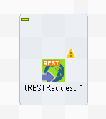
interface
switch(content-type){
case xml:
case csv:
case object:
default json:
}

Slide 55
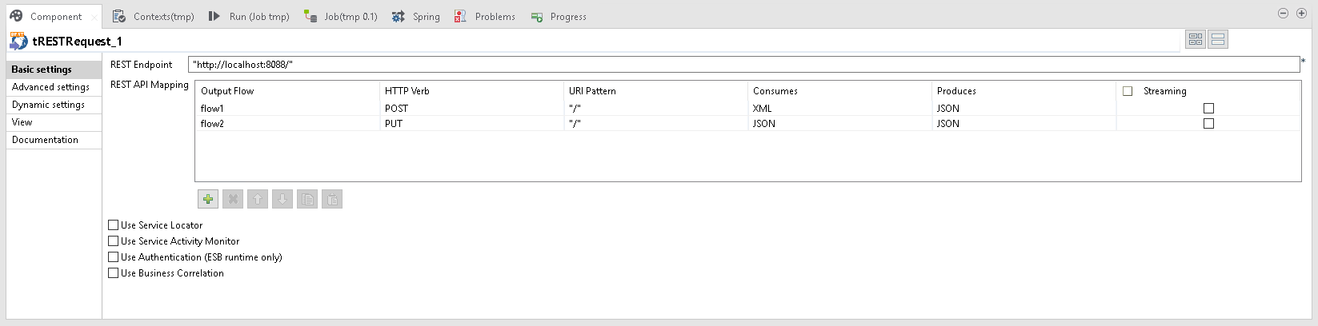


Slide 56
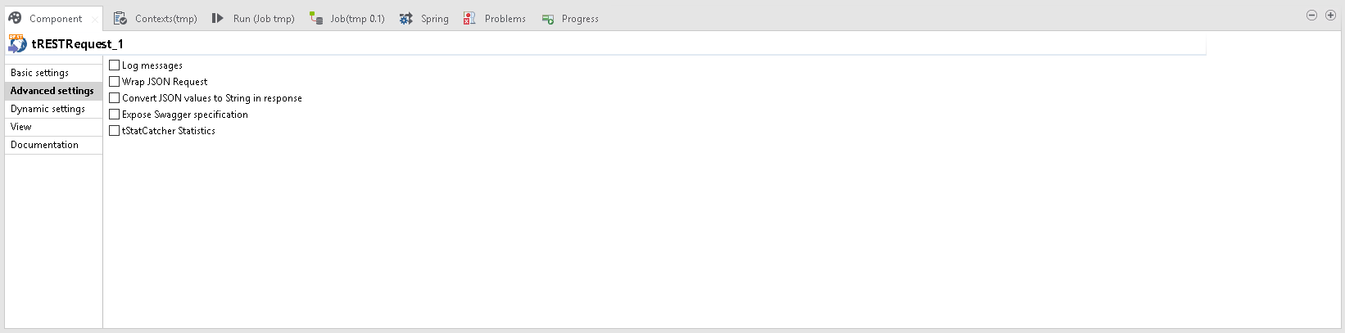
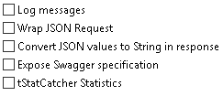

Slide 57
interface
service
component
meta
switch(content-type){
case xml:
case csv:
case object:
default json:
}
{
_id : surrogate key,
author : “john smith”,
source_name : “app_01”,
source_uid : “5002634”
category : “monitoring”,
subcategory: “hardware”,
last_modified : 1490811072,
data_object : {
….
}
}
interface
translator
translator
meta
convert
xml to json
csv to json
object to json
data access
data persistence
save
Document Storage

Slide 58
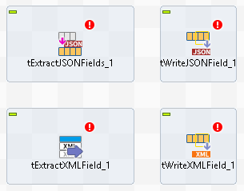
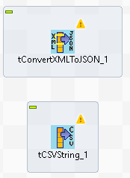
translator
convert
xml to json
csv to json
object to json

Slide 59
interface
service
component
meta
switch(content-type){
case xml:
case csv:
case object:
default json:
}
{
_id : surrogate key,
author : “john smith”,
source_name : “app_01”,
source_uid : “5002634”
category : “monitoring”,
subcategory: “hardware”,
last_modified : 1490811072,
data_object : {
….
}
}
interface
translator
translator
meta
convert
xml to json
csv to json
object to json
data access
data persistence
save
Document Storage

Slide 60
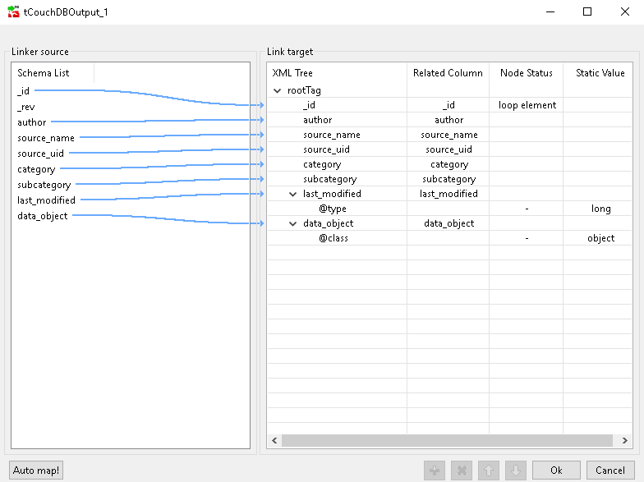
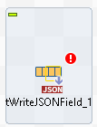
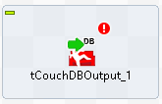
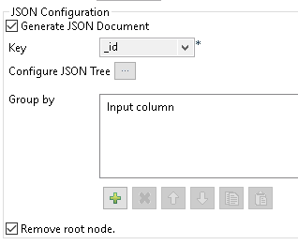
meta
{
_id : surrogate key,
author : “john smith”,
source_name : “app_01”,
source_uid : “5002634”
category : “monitoring”,
subcategory: “hardware”,
last_modified : 1490811072,
data_object : {
….
}
}

Slide 61
interface
service
component
meta
switch(content-type){
case xml:
case csv:
case object:
default json:
}
{
_id : surrogate key,
author : “john smith”,
source_name : “app_01”,
source_uid : “5002634”
category : “monitoring”,
subcategory: “hardware”,
last_modified : 1490811072,
data_object : {
….
}
}
interface
translator
translator
meta
convert
xml to json
csv to json
object to json
data access
data persistence
save
Document Storage

Slide 62
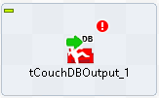
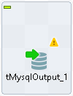
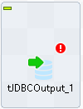
data persistence
save

Slide 63
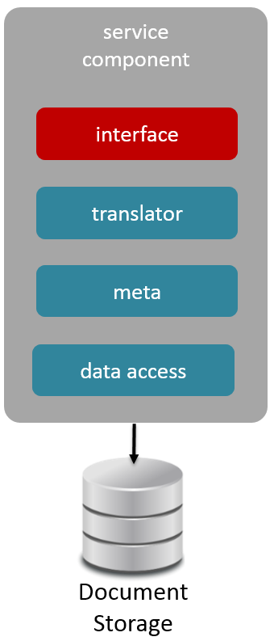
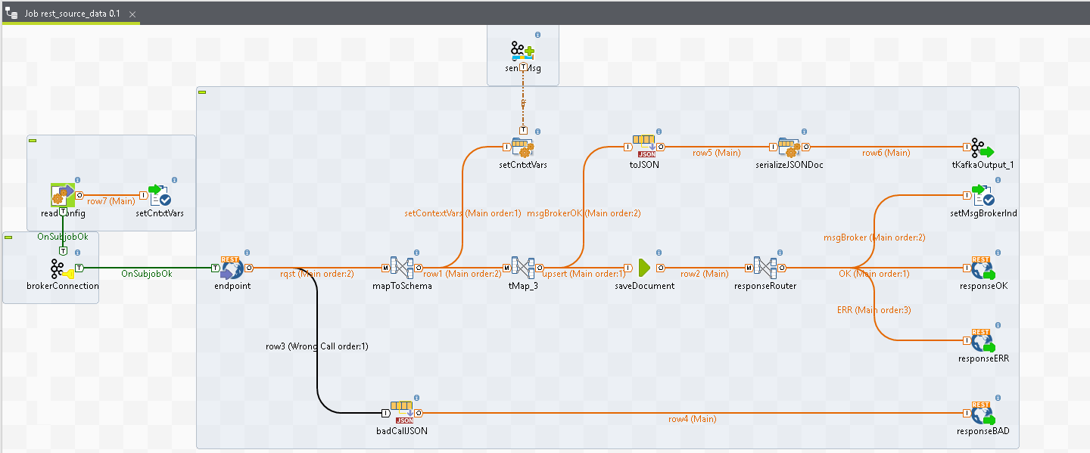
Sourcing of Data

Slide 64
Provisioning of Data

Slide 65
client request
client request
client request
api layer
service
component
service
component
service
component
service
component
service
component
module
module
module
module
module
message broker
service
component
service
component
service
component
service
component
module
module
module
module

Slide 66
service
component
meta
data object
save
interface
interface
transformation
transformation
data persistence
data persistence
transformation logic
aggregations
slow changing dimension
fact-less fact
close out
send trigger message
logging
event timestamp
time to process
process name
surrogate key
close out

Slide 67
interface
service
component
data persistence
meta
data object
save
interface
transformation
transformation
data persistence
close out
transformation logic
aggregations
slow changing dimension
fact-less fact
close out
send trigger message
logging
event timestamp
time to process
process name
surrogate key

Slide 68
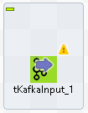
interface
meta
data object

Slide 69
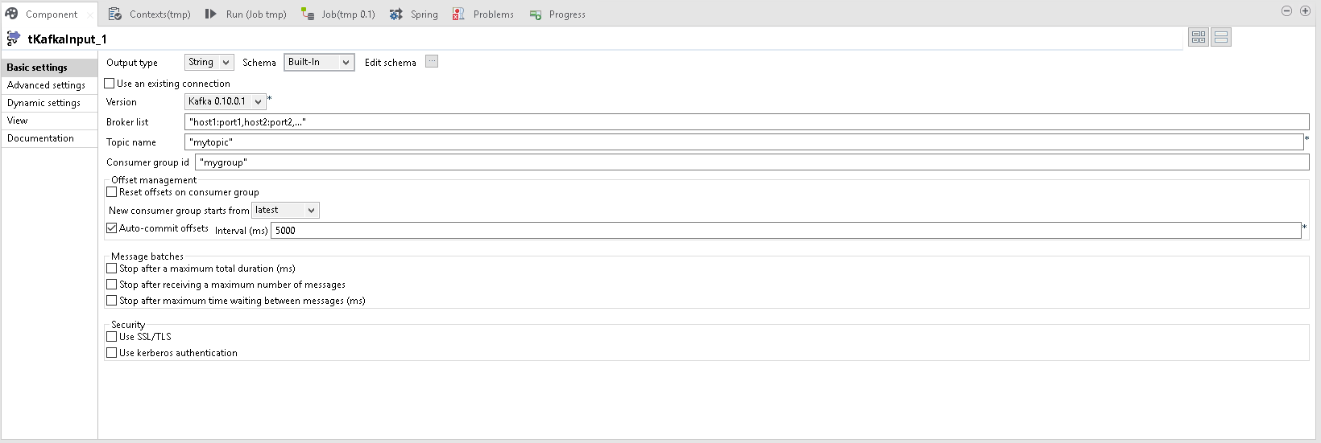

Slide 70
interface
service
component
data persistence
meta
data object
save
interface
transformation
transformation
data persistence
close out
transformation logic
aggregations
slow changing dimension
fact-less fact
close out
send trigger message
logging
event timestamp
time to process
process name
surrogate key

Slide 71
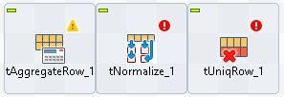
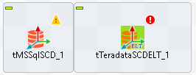
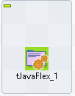
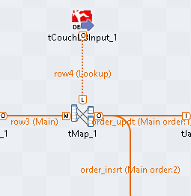
transformation
transformation logic
aggregations
slow changing dimension
fact-less fact

Slide 72
interface
service
component
data persistence
meta
data object
save
interface
transformation
transformation
data persistence
close out
transformation logic
aggregations
slow changing dimension
fact-less fact
close out
send trigger message
logging
event timestamp
time to process
process name
surrogate key

Slide 73
data persistence
save

Slide 74
interface
service
component
data persistence
meta
data object
save
interface
transformation
transformation
data persistence
close out
transformation logic
aggregations
slow changing dimension
fact-less fact
close out
send trigger message
logging
event timestamp
time to process
process name
surrogate key

Slide 75
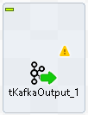
close out
send trigger message
logging
event timestamp
time to process
process name
surrogate key

Slide 76
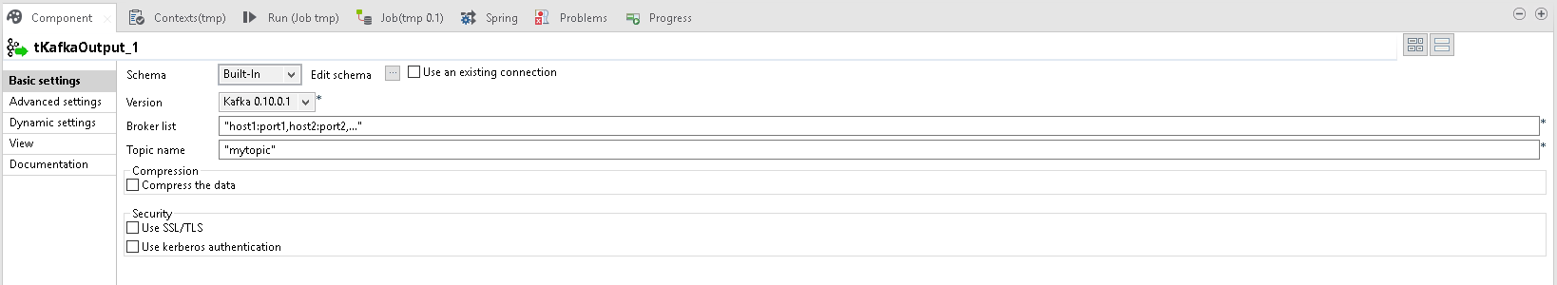

Slide 77
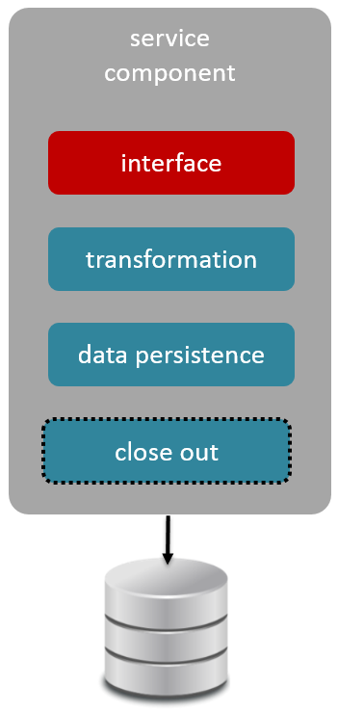
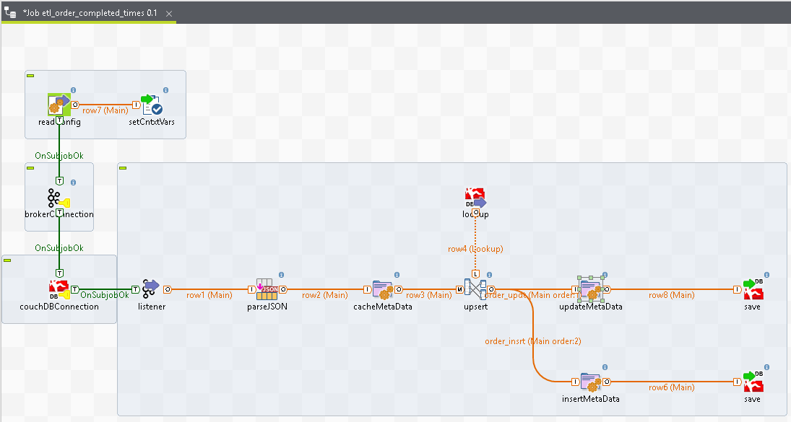
Provisioning of Data

Slide 78
Publishing of Data

Slide 79
client request
client request
client request
api layer
service
component
service
component
service
component
service
component
service
component
module
module
module
module
module
message broker
service
component
service
component
service
component
service
component
module
module
module
module

Slide 80
service
component
interface
interface
service
component
translator
translator
module
data persistence
data persistence
close out
close out

Slide 81
service
component
access management
switch(content-type){
case xml:
case csv:
case object:
default json:
}
retrieve data
filter
sort
simple aggregates
interface
interface
translator
translator
data persistence
data persistence
convert
xml to json
csv to json
object to json
close out
logging
event timestamp
time to process
close out

Slide 82
interface
service
component
data persistence
access management
switch(content-type){
case xml:
case csv:
case object:
default json:
}
retrieve data
filter
sort
simple aggregates
interface
translator
translator
data persistence
close out
convert
xml to json
csv to json
object to json
close out
logging
event timestamp
time to process

Slide 83
interface
access management
switch(content-type){
case xml:
case csv:
case object:
default json:
}

Slide 84
interface
service
component
data persistence
access management
switch(content-type){
case xml:
case csv:
case object:
default json:
}
retrieve data
filter
sort
simple aggregates
interface
translator
translator
data persistence
close out
convert
xml to json
csv to json
object to json
close out
logging
event timestamp
time to process

Slide 85
translator
convert
xml to json
csv to json
object to json

Slide 86
interface
service
component
data persistence
access management
switch(content-type){
case xml:
case csv:
case object:
default json:
}
retrieve data
filter
sort
simple aggregates
interface
translator
translator
data persistence
close out
convert
xml to json
csv to json
object to json
close out
logging
event timestamp
time to process

Slide 87

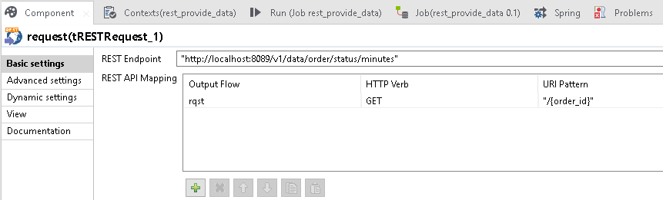

data persistence
retrieve data
filter
sort
simple aggregates

Slide 88
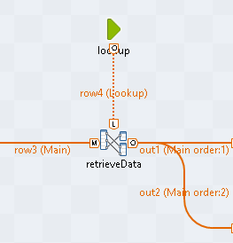

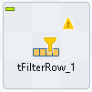

Slide 89
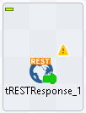
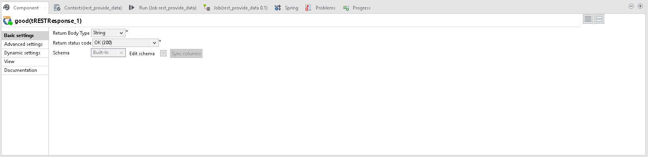


Slide 90
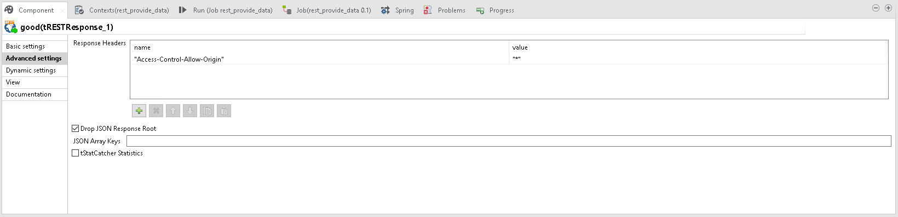

Slide 91
interface
service
component
data persistence
access management
switch(content-type){
case xml:
case csv:
case object:
default json:
}
retrieve data
filter
sort
simple aggregates
interface
translator
translator
data persistence
close out
convert
xml to json
csv to json
object to json
close out
logging
event timestamp
time to process

Slide 92
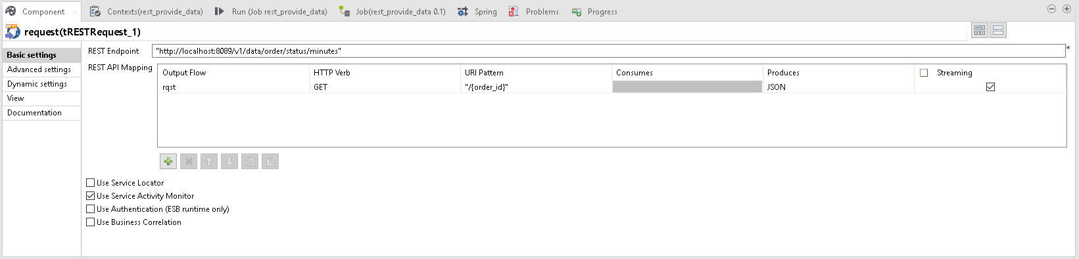
close out
logging
event timestamp
time to process

Slide 93
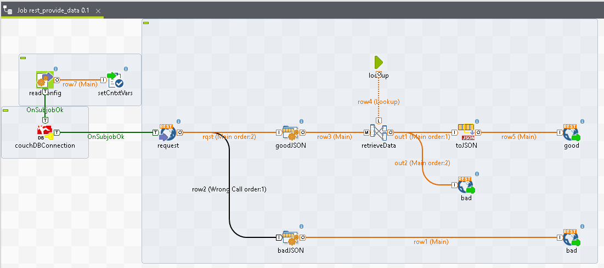
Publishing of Data

Slide 94
1
setting expectations
2
anti-patterns
3
DaaS pattern
4
building DaaS with Talend Open Studio

Slide 95
“Got It!”
“Darn”
“Almost”
“Doh!”
GO!

